Slide 1



.Milley Presentation.

Slide 2
SignalR
Topics Covered
SignalR Fundamentals
SignalR .NET Client
SignalR Identity User
SignalR Groups
8 Different Projects

Slide 3


HTTP
Request
Response
Request
Response
CLIENT
SERVER

Slide 4
SignalR Transport Type
01
Web Sockets
02
SSE (Server Sent Events)
03
Long Polling

Slide 5
Hubs SignalR
.NET Core MVC
CLIENT
CLIENT
/home/index
/home/privacy
/order/index
/order/list
CLIENT
https://domain.com/Home/Index
/hubs/userCount
CLIENT

Slide 6

SignalR Typical Flow
1
Create SignalR Hub
2
Add Methods to Hub
3
Add Client side SignalR
4
Connect to SignalR Hub from Client JS
5
Call SignalR Hub method
6
SignalR Hub invokes method in Client JS to notify clients.
7
Client receives update from SignalR hub and performs action

Slide 7
WEB SOCKETS
CLIENT 1
two-way connection
two-way connection
CLIENT 2
SERVER

Slide 8
Server Sent Events
Request / Connection
Event
Event
Event
CLIENT
SERVER

Slide 9

LONG POLLING
Request
~2min
Timeout
Request
Response
Request
CLIENT
SERVER

Slide 10
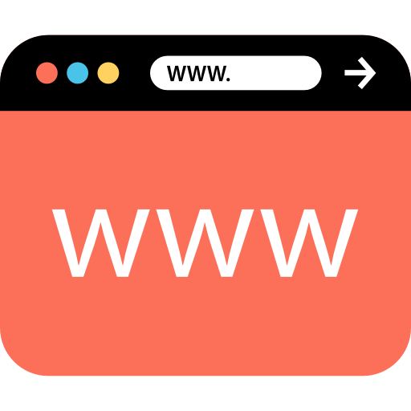
SIGNALR CONNECTION
A
B
C
X
Y
Z
SERVER

Slide 11
SIGNALR CONNECTION
A
B
C
X
Y
Z
SERVER

Slide 12
SIGNALR CONNECTION
A
B
C
X
Y
Z
SERVER

Slide 13
SIGNALR CONNECTION
A
B
C
X
Y
Z
SERVER

Slide 14
SIGNALR CONNECTION
A
B
C
X
Y
Z
SERVER

Slide 15
SIGNALR CONNECTION
A
B
C
X
Y
Z
SERVER

Slide 16
SIGNALR CONNECTION
A
B
C
X
Y
Z
SERVER

Slide 17
SIGNALR CONNECTION
ben@gmail.com
A
ben@gmail.com
B
sam@gmail.com
C
sam@gmail.com
X
jess@gmail.com
Y
jess@gmail.com
Z
SERVER

Slide 18
SIGNALR CONNECTION
ben@gmail.com
A
ben@gmail.com
B
sam@gmail.com
C
sam@gmail.com
X
jess@gmail.com
Y
jess@gmail.com
Z
SERVER

Slide 19
SIGNALR CONNECTION
USER
ADMIN
SERVER
A
X
B
Y
C
Z

Slide 20
SIGNALR CONNECTION
USER
ADMIN
A
SERVER
A
X
B
Y
C
Z

Slide 21
SIGNALR CONNECTION
USER
ADMIN
A
SERVER
B
A
X
B
Y
C
Z

Slide 22
SIGNALR CONNECTION
USER
ADMIN
A
SERVER
B
C
A
X
B
Y
C
Z

Slide 23
SIGNALR CONNECTION
USER
ADMIN
C
A
SERVER
B
C
A
X
B
Y
C
Z

Slide 24
SIGNALR CONNECTION
USER
ADMIN
C
A
X
SERVER
B
C
A
X
X
B
Y
C
Z

Slide 25
SIGNALR CONNECTION
USER
ADMIN
C
A
X
SERVER
B
C
A
X
B
Y
C
Z

Slide 26
SIGNALR CONNECTION
ADMIN
ben@gmail.com
A
ben@gmail.com
B
USER
sam@gmail.com
C
sam@gmail.com
X
jess@gmail.com
Y
jess@gmail.com
SERVER
Z

Slide 27
SIGNALR CONNECTION
ADMIN
ben@gmail.com
A
ben@gmail.com
B
USER
sam@gmail.com
C
sam@gmail.com
X
jess@gmail.com
Y
jess@gmail.com
SERVER
Z

Slide 28
SIGNALR CONNECTION
ADMIN
ben@gmail.com
A
ben@gmail.com
B
USER
sam@gmail.com
C
sam@gmail.com
X
jess@gmail.com
Y
jess@gmail.com
SERVER
Z

Slide 29
SIGNALR CONNECTION
ADMIN
ben@gmail.com
A
ben@gmail.com
B
USER
sam@gmail.com
C
sam@gmail.com
X
jess@gmail.com
Y
jess@gmail.com
SERVER
Z

Slide 30
SIGNALR CONNECTION
ADMIN
ben@gmail.com
A
ben@gmail.com
B
USER
sam@gmail.com
C
sam@gmail.com
X
jess@gmail.com
Y
jess@gmail.com
SERVER
Z

Slide 31
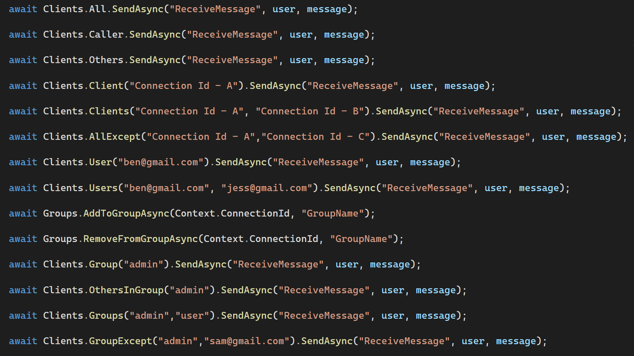
SIGNALR CONNECTION

